Slide 1
Chapter 4
IR Models

Slide 2
IR Models - Basic Concepts
Word evidence:
  IR systems usually adopt index terms to index and retrieve documents
  Each document is represented by a set of representative keywords or index terms (called Bag of Words)
An index term is a document word useful for remembering the document main themes
Not all terms are equally useful for representing the document contents:
  less frequent terms allow identifying a narrower set of documents
  But no ordering information is attached to the Bag of Words identified from the document collection.

Slide 3
IR Models - Basic Concepts
One central problem regarding IR systems is the issue of predicting the degree of relevance of documents for a given query
  Such a decision is usually dependent on a ranking algorithm which attempts to establish a simple ordering of the documents retrieved
  Documents appearning at the top of this ordering are considered to be more likely to be relevant
Thus ranking algorithms are at the core of IR systems
  The IR models determine the predictions of what is relevant and what is not, based on the notion of relevance implemented by the system

Slide 4
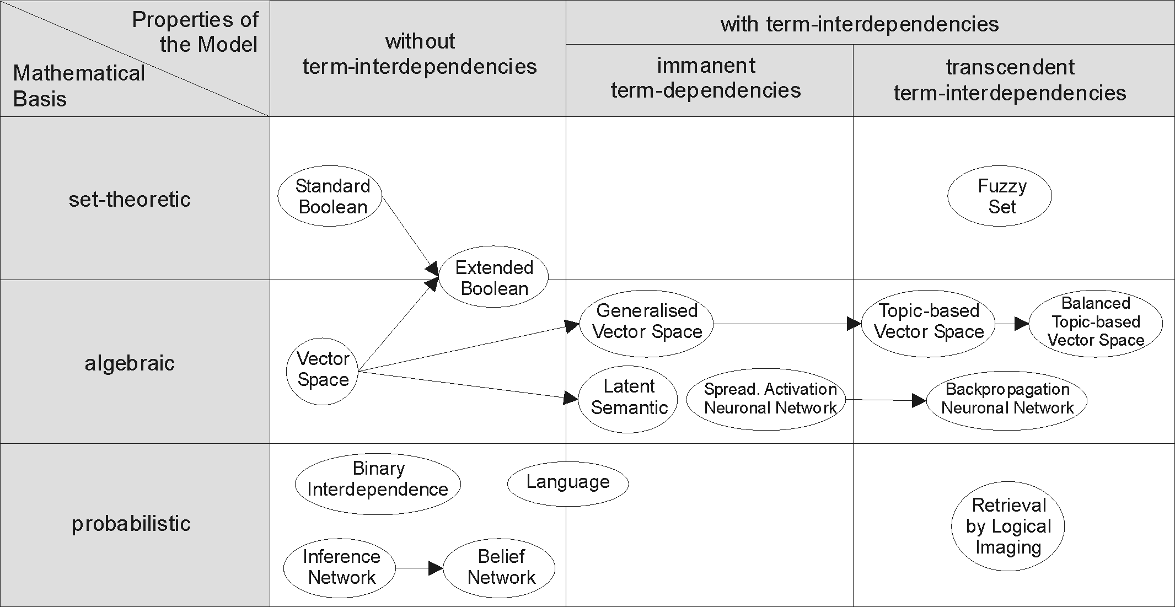
Alternative IR models
Probabilistic
relevance

Slide 5
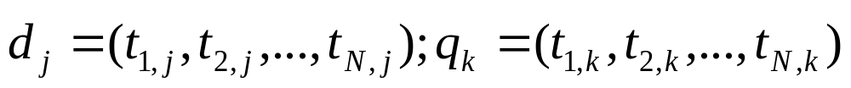
How to find relevant documents for a query?
Step 1: Map documents & queries into term-document vector space. Note that queries are considered as short document
  Represent both documents & queries as N-dimensional vectors in a term-document matrix, which shows occurrence of terms in the document collection or query
T₁ T₂ …. T_{N}
D₁ … … .. … …
D₂ … … .. … …
: … … ..… …: … … ..… … D_{M} … … .. … … Q_{i} … … .. … …
Document collection is mapped to term-by-document matrix
View as vector in multidimensional space
    Nearby vectors are related

Slide 6
How to find relevant documents for a query?
Step 2: Queries and documents are represented as weighted vectors, w_{ij}
  Why we need weighting techniques?
    To know the importance of a term in describing the content of a given document?
  There are binary weights & non-binary weighting technique. Any difference between the two?
  What method you recommend to compute weights for term i in document j and query q; w_{ij} and w_{iq} ?
T₁ T₂ …. T_{N}
D₁ w₁₁ w₁₂ … w_{1N}
D₂ w₂₁ w₂₂ … w_{2N}
: : : :
: : : :
D_{M} w_{M1} w_{M2} … w_{MN}
Q_{i} w_{i1} w_{i2} … w_{iN}
An entry in the matrix corresponds to the “weight” of a term in the document; zero means the term doesn’t exist in the document.
Normalize for vector length to avoid the effect of document length

Slide 7
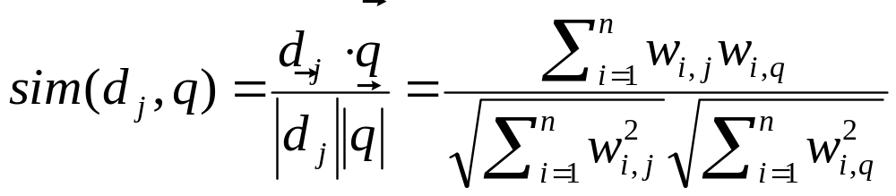
How to find relevant documents for a query?
Step 3: Rank documents (in increasing or decreasing order) based on their closeness to the query.
  Documents are ranked by the degree of their closeness to the query.
  How closeness of the document to query measured?
    It is determined by a similarity/dissimilarity score calculation
  How many matching (similarity/dissimilarity measurements) you know? Which one is best for IR?

Slide 8
How to evaluate Models?
We need to investigate what procedures the IR Models follow and what techniques they use:
  What is the weighting technique used by the IR Models for measuring importance of terms in documents?
    Are they using binary or non-binary weight?
  What is the matching technique used by the IR models?
    Are they measuring similarity or dissimilarity?
  Are they applying exact matching or partial matching in the course of finding relevant documents for a given query?
  Are they applying best matching principle to measure the degree of relevance of documents to display in ranked-order?
    Is there any Ranking mechanism applied before displaying relevant documents for the users?

Slide 9
The Boolean Model
Boolean model is a simple model based on set theory
  The Boolean model imposes a binary criterion for deciding relevance
Terms are either present or absent. Thus,
w_{ij} ε {0,1}
sim(q,d_{j}) = 1 - if document satisfies the boolean query
0 - otherwise
T₁ T₂ …. T_{N}
D₁ w₁₁ w₁₂ … w_{1N}
D₂ w₂₁ w₂₂ … w_{2N}
: : : :
: : : :
D_{M} w_{M1} w_{M2} … w_{MN}
Note that, no weights assigned in-between 0 and 1, just only values 0 or 1

Slide 10
The Boolean Model: Example
Given the following three documents, Construct Term – document matrix and find the relevant documents retrieved by the Boolean model for the query “gold silver truck”
D1: “Shipment of gold damaged in a fire”
D2: “Delivery of silver arrived in a silver truck”
D3: “Shipment of gold arrived in a truck”
Query: “gold silver truck”
    Table below shows document –term (t_{i}) matrix
Also find the documents relevant for the queries:
gold delivery;
ship gold;
silver truck
 | arrive | damage | deliver | fire | gold | silver | ship | truck
D1 | 0 | 1 | 0 | 1 | 1 | 0 | 1 | 0
D2 | 1 | 0 | 1 | 0 | 0 | 1 | 0 | 1
D3 | 1 | 0 | 0 | 0 | 1 | 0 | 1 | 1
query | 0 | 0 | 0 | 0 | 1 | 1 | 0 | 1

Slide 11
The Boolean Model: Example
Generate the relevant documents retrieved by the Boolean model for the query :
  q = k1 ∧ (k2 ∨ ¬k3)
    1. k1 = {D1, D2, D4, D5, D6}
    2. k2 = {D3, D5, D6, D7}
    3. k3 = {D1, D3, D5}
  Query: q = k1 ∧ (k2 ∨ ¬k3)
Answer: {D1, D2, D4, D5, D6} ∩ ({D3, D5, D6, D7} ∪{D2, D4, D6, D7})
        = {D2, D4, D5, D6}
k2
k1
d7
d2
d6
d4
d5
d3
d1
k3

Slide 12
The Boolean Model: Example
Given the following determine documents retrieved by the Boolean model based IR system
  Index Terms: K1, …,K8.
  Documents:
    1. D1 = {K1, K2, K3, K4, K5}
    2. D2 = {K1, K2, K3, K4}
    3. D3 = {K2, K4, K6, K8}
    4. D4 = {K1, K3, K5, K7}
    5. D5 = {K4, K5, K6, K7, K8}
    6. D6 = {K1, K2, K3, K4}
  Query: K1∧ (K2 ∨ ¬K3)
Answer: {D1, D2, D4, D6} ∩ ({D1, D2, D3, D6} ∪{D3, D5})
        = {D1, D2, D6}

Slide 13
Exercise
Given the following four documents with the following contents:
  D₁ = “computer information retrieval”
  D₂ = “computer retrieval”
  D₃ = “information”
  D₄ = “computer information”
What are the relevant documents retrieved for the queries:
  Q₁ = “information ∧ retrieval”
  Q₂ = “information ∧ ¬computer”

Slide 14
Drawbacks of the Boolean Model
Retrieval based on binary decision criteria with no notion of partial matching
No ranking of the documents is provided (absence of a grading scale)
Information need has to be translated into a Boolean expression which most users find awkward
The Boolean queries formulated by the users are most often too simplistic
  As a consequence, the Boolean model frequently returns either too few or too many documents in response to a user query

Slide 15
Vector-Space Model
This is the most commonly used strategy for measuring relevance of documents for a given query. This is because,
  Use of binary weights is too limiting
  Non-binary weights provide consideration for partial matches
These term weights are used to compute a degree of similarity between a query and each document
  Ranked set of documents provides for better matching
The idea behind VSM is that
  the meaning of a document is conveyed by the words used in that document

Slide 16
Vector-Space Model
To find relevant documens for a given query,
First, map documents and queries into term-document vector space.
  Note that queries are considered as short document
Second, in the vector space, queries and documents are represented as weighted vectors, w_{ij}
  There are different weighting technique; the most widely used one is computing TF*IDF weight for each term
Third, similarity measurement is used to rank documents by the closeness of their vectors to the query.
  To measure closeness of documents to the query cosine similarity score is used by most search engines

Slide 17
Term-document matrix.
A collection of n documents and query can be represented in the vector space model by a term-document matrix.
  An entry in the matrix corresponds to the “weight” of a term in the document;
  zero means the term has no significance in the document or it simply doesn’t exist in the document. Otherwise, w_{ij} > 0 whenever k_{i} ∈ d_{j}
T₁ T₂ …. T_{N}
D₁ w₁₁ w₂₁ … w_{1N}
D₂ w₂₁ w₂₂ … w_{2N}
: : : :
: : : :
D_{M} w_{M1} w_{M2} … w_{MN}

Slide 18
Computing weights
How to compute weights for term i in document j and query q; w_{ij} and w_{iq} ?
A good weight must take into account two effects:
  Quantification of intra-document contents (similarity)
    tf factor, the term frequency within a document
  Quantification of inter-documents separation (dissimilarity)
    idf factor, the inverse document frequency
As a result of which most IR systems are using tf*idf weighting technique:
w_{ij} = tf(i,j) * idf(i)

Slide 19
Computing weights
Let,
  N be the total number of documents in the collection
  n_{i} be the number of documents which contain t_{i}
  freq(i,j) raw frequency of t_{i} within d_{j}
A normalized tf(i,j) factor is given by
  tf(i,j) = freq(i,j) / max(freq(k,j))
  where the maximum is computed over all terms which occur within the document d_{j}
The idf factor is computed as
  idf(i) = log (N/n_{i})
  The log is used to make the values of tf and idf comparable. It can also be interpreted as the amount of information associated with the term t_{i}.
A normalized tf*idf weight is given by:
  w_{ij} = freq(i,j) / max(freq(k,j)) * log(N/n_{i})

Slide 20
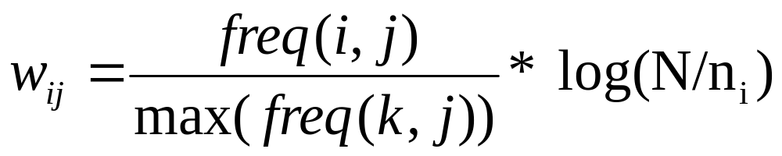
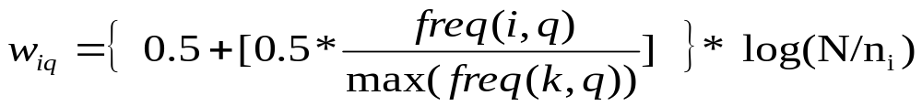
Computing weights
The vector space model with TF*IDF weights is a good ranking strategy with general collections
For index terms a normalized TF*IDF weight is given by:
Users query is typically treated as a short document and also TF-IDF weighted.
  For the query term weights, a suggestion is
The vector space model is usually as good as the known ranking alternatives. It is also simple and fast to compute.

Slide 21
Example: Computing weights
A collection includes 10,000 documents
  The term t_{A} appears 20 times in a particular document j
  The maximum appearance of term t_{k} in document j is 50 times
  The term t_{A} appears in 2,000 of the document collections.
Compute TF*IDF weight of term A?
  tf(A,j) = freq(A,j) / max(freq(k,j)) = 20/50 = 0.4
  idf(A) = log(N/DF_{A}) = log (10,000/2,000) = log(5) = 2.32
  w_{Aj} = tf(A,j) * log(N/DF_{A}) = 0.4 * 2.32 = 0.928

Slide 22
Similarity Measure
A similarity measure is a function that computes the degree of similarity/dissimilarity between document j and users query.
Using a similarity score between the query and each document:
  It is possible to apply best matching such that documents are ranked for retrieval in the order of presumed relevance.
  It is possible to enforce a certain threshold so that we can control the size of the retrieved set of documents.

Slide 23
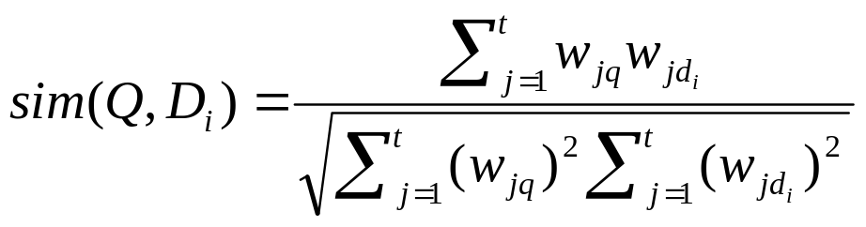

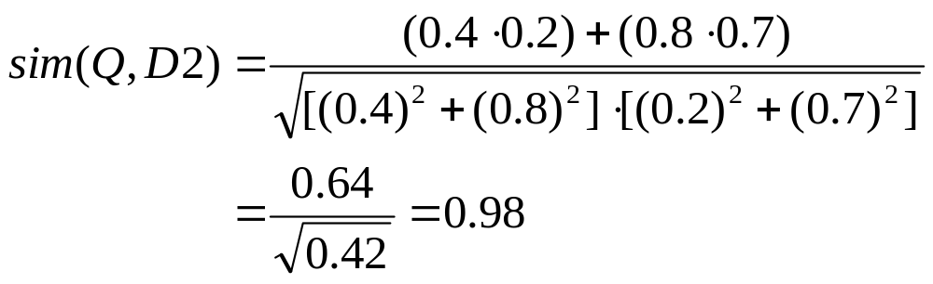

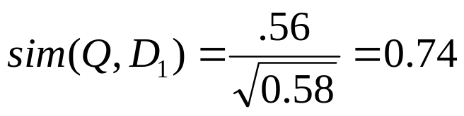
Vector Space with Term Weights and Cosine Similarity Measure
D_{i}=(d_{1i},w_{1di};d_{2i}, w_{2di};…;d_{ti}, w_{tdi})
Q =(q_{1i},w_{1qi};q_{2i}, w_{2qi};…;q_{ti}, w_{tqi})
Term B
1.0
Q = (0.4,0.8)
D1=(0.8,0.3)
D2=(0.2,0.7)
D₂
Q
0.8
0.6
0.4
D₁
0.2
0
0.2
0.4
0.6
0.8
1.0
Term A

Slide 24
Example Vector-Space Model
Suppose user query for: Q = “gold silver truck”. The database collection consists of three documents with the following content.
  D1: “Shipment of gold damaged in a fire”
  D2: “Delivery of silver arrived in a silver truck”
  D3: “Shipment of gold arrived in a truck”
Show retrieval results in ranked order?
  Assume that full text terms are used during indexing, without removing common terms, stop words, & also no terms are stemmed.
  Assume that content-bearing terms are selected during indexing
  Also compare your result with or without normalizing term frequency

Slide 25
Example VSM: Weighting Terms
Terms | Q | Counts TF |  |  | DF | IDF | W_{i} = TF*IDF
 |  | D1 | D2 | D3 |  |  | Q | D1 | D2 | D3
arrive | 0 | 0 | 1 | 1 | 2 | 0.176 | 0 | 0 | 0.176 | 0.176
damage | 0 | 1 | 0 | 0 | 1 | 0.477 | 0 | 0.477 | 0 | 0
deliver | 0 | 0 | 1 | 0 | 1 | 0.477 | 0 | 0 | 0.477 | 0
fire | 0 | 1 | 0 | 0 | 1 | 0.477 | 0 | 0.477 | 0 | 0
gold | 1 | 1 | 0 | 1 | 2 | 0.176 | 0.176 | 0.176 | 0 | 0.176
silver | 1 | 0 | 2 | 0 | 1 | 0.477 | 0.477 | 0 | 0.954 | 0
ship | 0 | 1 | 0 | 1 | 2 | 0.176 | 0 | 0.176 | 0 | 0.176
truck | 1 | 0 | 1 | 1 | 2 | 0.176 | 0.176 | 0 | 0.176 | 0.176

Slide 26
Example VSM: Weighting Terms
Terms | Q | D1 | D2 | D3
arrive | 0 | 0 | 0.176 | 0.176
damage | 0 | 0.477 | 0 | 0
deliver | 0 | 0 | 0.477 | 0
fire | 0 | 0.477 | 0 | 0
gold | 0.176 | 0.176 | 0 | 0.176
silver | 0.477 | 0 | 0.954 | 0
ship | 0 | 0.176 | 0 | 0.176
truck | 0.176 | 0 | 0.176 | 0.176

Slide 27
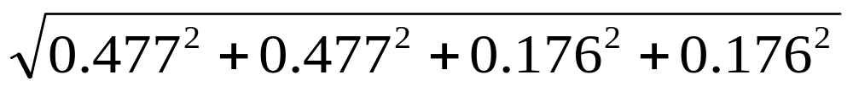
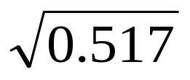
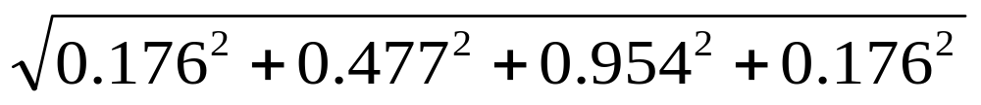
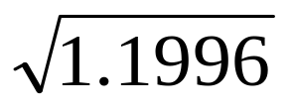
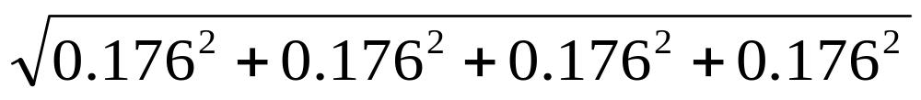
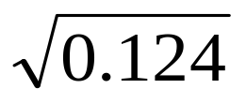
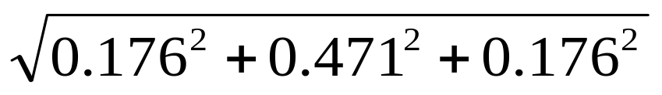
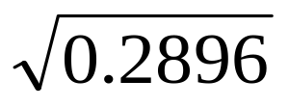
Example VSM: similarity Measure
Compute similarity using cosine Sim(q,d1)
First, for each document and query, compute all vector lengths (zero terms ignored)
|d₁|= = = 0.719
|d₂|= = = 1.095
|d₃|= = = 0.352
|q|= = = 0.538
Next, compute dot products (zero products ignored)
Q*d1= 0.176*0.176 = 0.0310
Q*d2 = (0.954*0.477) + (0.176 *0.176) = 0.4862
Q*d3 = (0.176*0.176) + (0.176*0.176) = 0.0620

Slide 28
Example VSM: Ranking
Now, compute similarity score
Sim(q,d₁) = (0.0310) / (0.538*0.719) = 0.0801
Sim(q,d₂) = (0.4862 ) / (0.538*1.095)= 0.8246
Sim(q,d₃) = (0.0620) / (0.538*0.352)= 0.3271
Finally, we sort and rank documents in descending order according to the similarity scores
    Rank 1: Doc 2 = 0.8246
    Rank 2: Doc 3 = 0.3271
    Rank 3: Doc 1 = 0.0801
    Exercise: using normalized TF, rank documents using cosine similarity measure? Hint: Normalize TF of term i in doc j using max frequency of a term k in document j.

Slide 29
Vector-Space Model
Advantages:
  Term-weighting improves quality of the answer set since it helps to display relevant documents in ranked order
  Partial matching allows retrieval of documents that approximate the query conditions
  Cosine ranking formula sorts documents according to degree of similarity to the query
Disadvantages:
  Assumes independence of index terms. It doesn’t relate one term with another term
  Computationally expensive since it measures the similarity between each document and the query

Slide 30
Exercise 1
Suppose the database collection consists of the following documents.
c1: Human machine interface for Lab ABC computer applications
c2: A survey of user opinion of computer system response time
c3: The EPS user interface management system
c4: System and human system engineering testing of EPS
c5: Relation of user-perceived response time to error measure
M1: The generation of random, binary, unordered trees
M2: The intersection graph of paths in trees
M3: Graph minors: Widths of trees and well-quasi-ordering
m4: Graph minors: A survey
Query:
Find documents relevant to "human computer interaction"

Slide 31
Exercise 2
Consider these documents:
Doc 1 breakthrough drug for schizophrenia
Doc 2 new schizophrenia drug
Doc 3 new approach for treatment of schizophrenia
Doc 4 new hopes for schizophrenia patients
  Draw the term-document incidence matrix for this document collection.
  Draw the inverted index representation for this collection.
For the document collection shown above, what are the returned results for the queries:
  schizophrenia AND drug
  for AND NOT(drug OR approach)

Slide 32
Probabilistic Model
IR is an uncertain process
  Mapping Information need to Query is not perfect
  Mapping Documents to index terms is a logical representation
  Query terms and index terms mostly mismatch
This situation leads to several statistical approaches: probability theory, fuzzy logic, theory of evidence, language modeling, etc.
Probabilistic retrieval model is rigorous formal model that attempts to predict the probability that a given document will be relevant to a given query; i.e. Prob(R|(q,di))
  Use probability to estimate the “odds” of relevance of a query to a document.
  It relies on accurate estimates of probabilities

Slide 33
Probability Ranking Principle
The relevance of a given document for users query can be determined by the probability score
  High probability (prob(rel | d_{i} q): means more likely for users to get relevant information by reading document d_{i}.
A Probabilistic retrieval model follows Probability ranking principle
  You have a collection of Documents
    A set of relevant documents needs to be returned for queries issued by users
    Intuitively, want the “best” document to be first, second best - second, etc…
  According to probability ranking principle, documents are ranked in decreasing order of probability of relevance to users information need
  If p(R|D) > p(NR|D) then D is relevant,
  otherwise D is not relevant

Slide 34
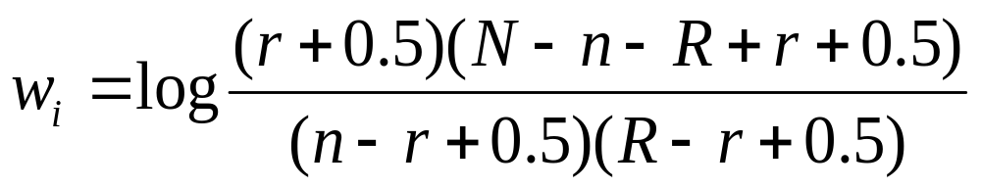
Terms Existence in Relevant Document
N=the total number of documents in the collection
n= the total number of documents that contain term t_{i}
R=the total number of relevant documents retrieved
r=the total number of relevant documents retrieved that contain term t_{i}
For term t_{i} | Document Relevance
 | No of relevant docs | No of non-relevant docs | Total
No of docs including term t_{i} | r | n-r | n
No of docs excluding term t_{i} | R-r | N-R-(n-r) | N-n
Total | R | N-R | N

Slide 35

Computing term probabilities
Three cases: Relevance of documents for a given query may be known, partially known or unknown
  Initially, there are no retrieved documents
  R is completely unknown
  Assume P(t_{i}|R) is constant (usually 0.5)
  Assume P(t_{i}|NR) approximated by distribution of t_{i} across collection – IDF
This can be used to compute an initial rank using IDF as the basic term weight

Slide 36
Probabilistic Model Example
d | Document vectors <tf_{d,t}>
 | cold | day | eat | hot | lot | nine | old | pea | pizza | pot
1 | 1 |  |  | 1 |  |  |  | 1 | 1
2 |  |  |  |  |  |  |  | 1 | 1 | 1
3 |  | 1 |  |  |  | 1 | 1
4 | 1 |  |  | 1 |  |  |  |  |  | 1
5 |  |  |  |  |  |  |  | 1 | 1
6 |  |  | 1 |  | 1
w_{t} | 0.26 | 0.56 | 0.56 | 0.26 | 0.56 | 0.56 | 0.56 | 0.0 | 0.0 | 0.26
q₁ = eat =>0.56
q₂ = eat pizza=> 0.56+0.0
q₄ = eat hot pizza=>0.56+0.26+0.0

Slide 37
Improving the Ranking
Now, suppose
  we have shown the initial ranking to the user
  the user has labeled some of the documents as relevant ("relevance feedback")
We now have
  N documents in collection, R are known relevant documents
  n_{i} documents containing t_{i}, out of which r_{i} are relevant

Slide 38
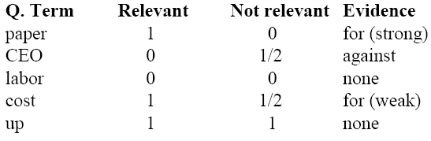
Probabilistic Retrieval Example
D1: “Cost of paper is up.” (relevant)
D2: “Cost of jellybeans is up.” (not relevant)
D3: “Salaries of CEO’s are up.” (not relevant)
D4: “Paper: CEO’s labor cost up.” (????)

Slide 39
Pros & Cons Probabilistic model
Probabilistic model uses probability theory to model the uncertainty in the retrieval process
  Assumptions are made explicit
  Term weight without relevance information is IDF
Relevance feedback can improve the ranking by giving better term probability estimates
Advantages of probabilistic model over vector‐space
  Strong theoretical basis
  Since the base is probability theory, it is very well understood
  Easy to extend
Disadvantages
  Models are often complicated
  No term frequency weighting
Which is better: vector‐space or probabilistic?
  Both are approximately as good as each other
  Depends on collection, query, and other factors

